Slide 1
Pixel-Level Understanding & Real-Time Challenge
Week 7 - Day 3

Slide 2
What is Image Segmentation?
Assigns a class label to each pixel
Understands what and where — per pixel
More detailed than object detection
Types:
Semantic Segmentation: Classify regions (e.g., "road", "sky")
Instance Segmentation: Distinguish individual objects (e.g., 2 dogs)

Slide 3
Use Cases of Segmentation
Medical imaging (tumor segmentation)
Self-driving cars (road, lanes, pedestrians)
Satellite imagery (land use classification)
Agriculture (crop/weed detection)
Augmented reality (background removal)

Slide 4
U-Net – A Segmentation Classic
Designed for biomedical image segmentation
Encoder-decoder architecture
Skip connections help preserve spatial info
Architecture:
Left: Downsampling path (Conv + Pool)
Right: Upsampling path (ConvTranspose)
Horizontal skip connections

Slide 5
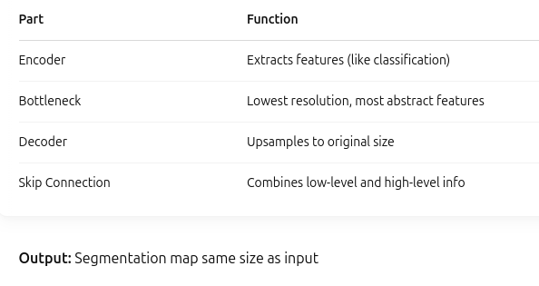
U-Net Architecture Explained

Slide 6
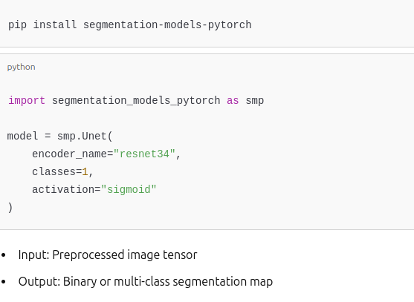
Running U-Net in Practice

Slide 7
SegFormer – Transformer-based Segmentation
Combines CNN + Transformer architecture
Lightweight yet powerful
Used in many state-of-the-art segmentation tasks

Slide 8
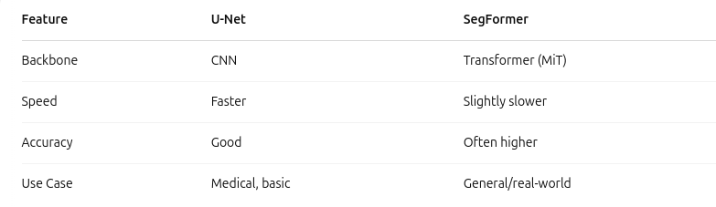
U-Net vs SegFormer

Slide 9
Dataset for Segmentation Task
Use small, open datasets like:
Oxford Pet Dataset
CamVid
ADE20K (sample subset)
Each image has:
Input image (RGB)
Target mask (pixel-wise class labels)

Slide 10
Running Segmentation on Images
Steps:
Preprocess image (resize, normalize)
Run model: pred = model(image)
Postprocess output:
Convert logits to mask
Map mask values to colors
Display result with matplotlib

Slide 11
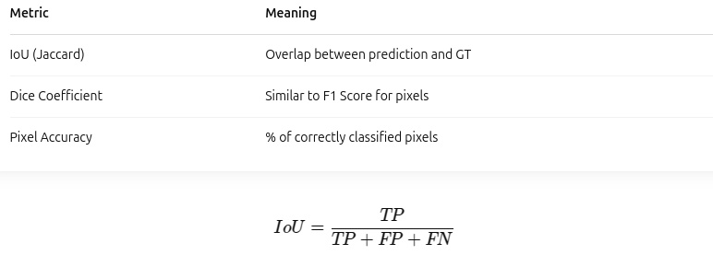
Evaluation Metrics for Segmentation

Slide 12
Limitations & Challenges in Segmentation
⚠️ Common Issues:
Slow inference (especially transformers)
Tiny objects may get missed
Label imbalance (class 0 = background dominates)
🛠️ Solutions:
Data augmentation
Class weighting
Using focal loss

